Slide 1





ASP.NET MVC Architecture
Layouts, Filters, Sections, Helpers, Partial Views, Areas…
ASP.NET MVC
SoftUni Team
Technical Trainers
Software University
http://softuni.bg

Slide 2

Table of Contents
Action Filters
Razor Views
Layouts and sections
Helpers
Partial views
Areas

Slide 3
Action Filters
Apply pre- and post-processing logic
Similar to HTTP Modules
Can be applied to actions and to controllers
Global filters can be registered in GlobalFilters.
Filters (or in /App_Start/FilterConfig.cs)
Name | Description
OutputCache | Cache the output of a controller
ValidateInput(false) | Turn off request validation and allow dangerous input (html tags)
Authorize | Restrict an action to authorized users or roles
ValidateAntiForgeryToken | Helps prevent cross site request forgeries
HandleError | Can specify a view to render in the event of an unhandled exception

Slide 4

Custom Action Filter
Create a C# class file in /Filters/
Inherit ActionFilterAttribute
We can override the following methods:
OnActionExecuting(ActionExecutingContext)
OnActionExecuted(ActionExecutedContext)
OnResultExecuting(ResultExecutingContext)
OnResultExecuted(ResultExecutedContext)
We can apply our new attribute to a controller, method or globally in GlobalFilters.Filters

Slide 5
Custom Action Filter (2)
public class LogAttribute : ActionFilterAttribute
{
public override void OnActionExecuting(ActionExecutingContext filterContext)
{ … }
public override void OnActionExecuted(ActionExecutedContext filterContext)
{ … }
public override void OnResultExecuting(ResultExecutingContext filterContext)
{ … }
public override void OnResultExecuted(ResultExecutedContext filterContext)
{ … }
}
[Log]
public class DepartmentController : Controller { … }

Slide 6
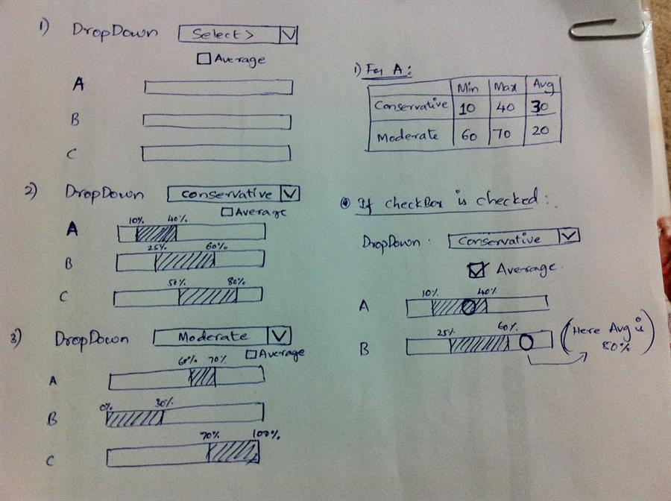
Advanced Razor Syntax

Slide 7
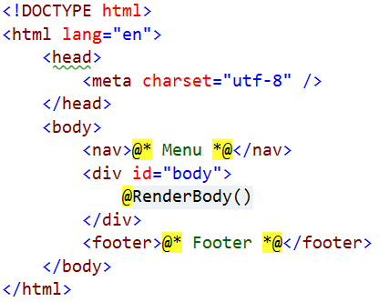
Layout
Defines a common site template
Similar to ASP.NET master pages (but better!)
Razor view engine renders content inside-out
First the view is rendered, then the layout
@RenderBody()
Indicates where the view content should be placed when rendering

Slide 8
Views and Layouts
Views don't need to specify layout since their default layout is set in their _ViewStart file:
~/Views/_ViewStart.cshtml (code for all views)
Each view can specify custom layout pages
Views without layout:
@{
Layout = "~/Views/Shared/_UncommonLayout.cshtml";
}
@{
Layout = null;
}

Slide 9
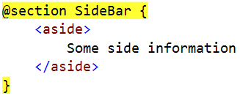
Sections
You can have one or more "sections" (optional)
They are defined in the views:
And may be rendered anywhere in the layout page using the method RenderSection()
@RenderSection(string name, bool required)
If the section is required and not defined, an exception will be thrown (IsSectionDefined())

Slide 10
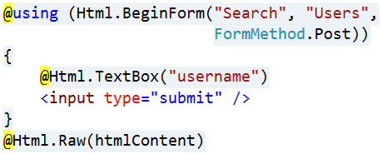
View Helpers
Each view inherits WebViewPage
ViewPage has a property named Html
Html property has methods that return string and can be used to generate HTML
Create inputs
Create links
Create forms
Other helper properties are also available
Ajax, Url, custom helpers

Slide 11
HTML Helpers
Method | Type | Description
BeginForm, BeginRouteForm | Form | Returns an internal object that represents an HTML form that the system uses to render the <form> tag
EndForm | Form | A void method, closes the pending </form> tag
CheckBox, CheckBoxFor | Input | Returns the HTML string for a check box input element
Hidden, HiddenFor | Input | Returns the HTML string for a hidden input element
Password, PasswordFor | Input | Returns the HTML string for a password input element
RadioButton, RadioButtonFor | Input | Returns the HTML string for a radio button input element
TextBox, TextBoxFor | Input | Returns the HTML string for a text input element
Label, LabelFor | Label | Returns the HTML string for an HTML label element

Slide 12
HTML Helpers (2)
Method | Type | Description
ActionLink, RouteLink | Link | Returns the HTML string for an HTML link
DropDownList, DropDownListFor | List | Returns the HTML string for a drop-down list
ListBox, ListBoxFor | List | Returns the HTML string for a list box
TextArea, TextAreaFor | TextArea | Returns the HTML string for a text area
Partial | Partial | Returns the HTML string incorporated in the specified user control
RenderPartial | Partial | Writes the HTML string incorporated in the specified user control to the output stream
ValidationMessage, ValidationMessageFor | Validation | Returns the HTML string for a validation message
ValidationSummary | Validation | Returns the HTML string for a validation summary message

Slide 13
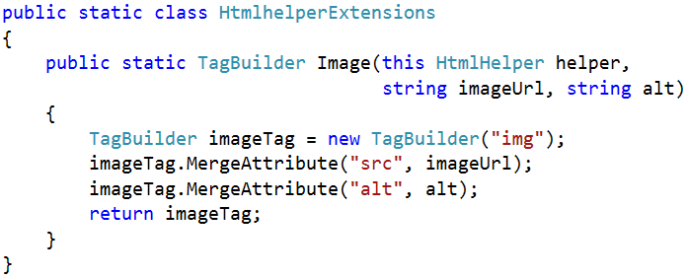

Custom Helpers
Write extension methods for the HtmlHelper
Return a string or override the ToString() method
The TagBuilder class manages closing tags and attributes
Add namespace in web.config (if needed)

Slide 14
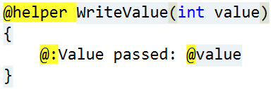
Custom Helpers (2)
Another way to write helpers:
Create the folder /App_Code/
Create a view in it (for example Helpers.cshtml)
Write a helper in it using @helper
You can use the helper in any view
You have a lot of code in views? => write helpers

Slide 15
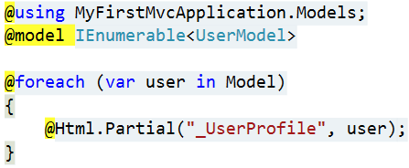
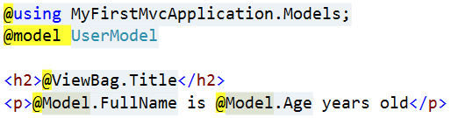
Partial Views
Partial views render portions of a page
Reuse pieces of a view
Html helpers – Partial(), RenderPartial() and Action()
Razor partial views are still .cshtml files
Sub-request
Located in the same folder as other views or in Shared folder

Slide 16
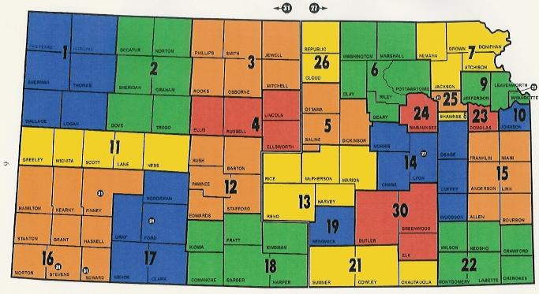
Areas

Slide 17
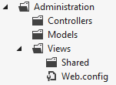
Areas
Some applications can have a large number of controllers
ASP.NET MVC lets us partition Web applications into smaller units (areas)
An area is effectively an MVC structure inside an application
Example: a large e-commerce application
Main store, users
Blog, forum
Administration

Slide 18
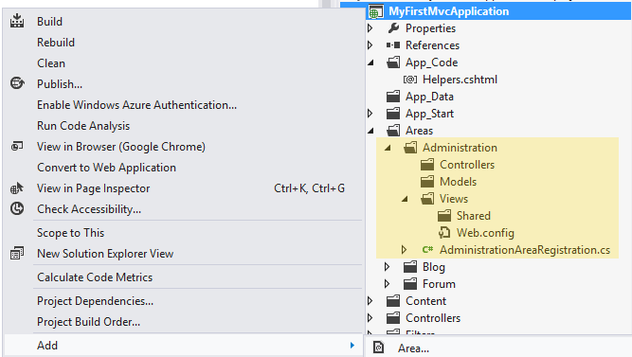
Demo: Areas
ASP.NET MVC structures (areas)

Slide 19

Summary
Layout, sections and partial views help us to separate the logic of our views
Helpers
Allow code reuse
Manage most of the complexity of writing HTML
Our project can be divided into areas
Smaller sections which have their own MVC structure

Slide 20









ASP.NET MVC Architecture
https://softuni.bg/trainings/1230/asp-net-mvc-october-2015

Slide 21
License
This course (slides, examples, demos, videos, homework, etc.) is licensed under the "Creative Commons Attribution-NonCommercial-ShareAlike 4.0 International" license
Attribution: this work may contain portions from
"ASP.NET MVC" course by Telerik Academy under CC-BY-NC-SA license

Slide 22





Free Trainings @ Software University
Software University Foundation – softuni.org
Software University – High-Quality Education, Profession and Job for Software Developers
softuni.bg
Software University @ Facebook
facebook.com/SoftwareUniversity
Software University @ YouTube
youtube.com/SoftwareUniversity
Software University Forums – forum.softuni.bg

